Slide 1

Case Study #2
Memi Lavi
www.memilavi.com

Slide 2
Muscar.auto
The Real Autonomous Car

Slide 3
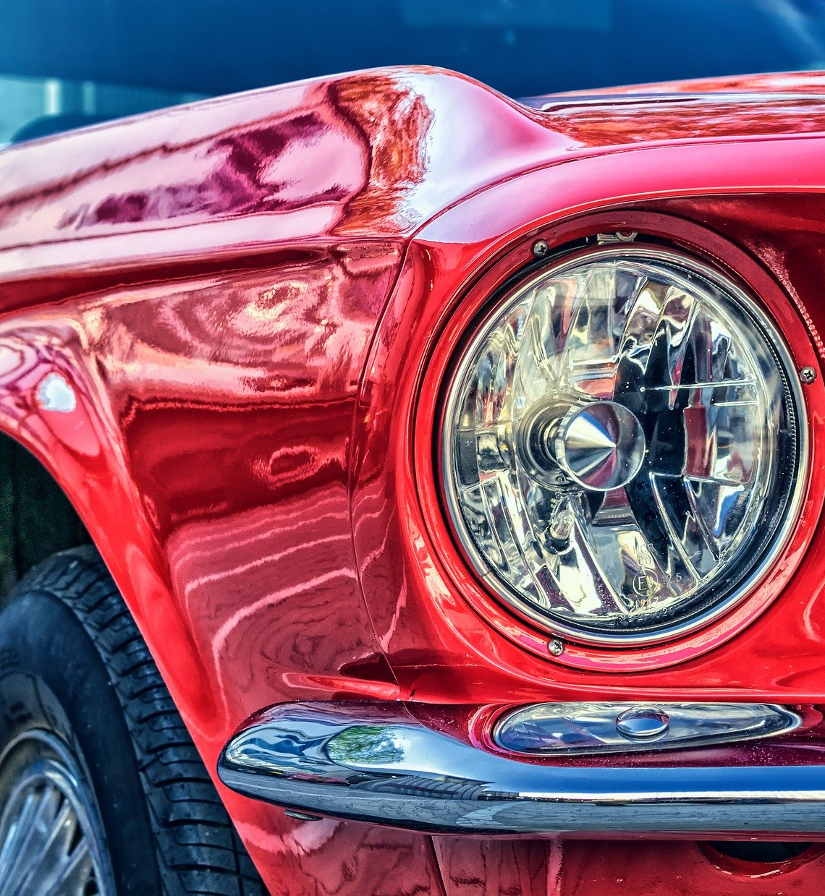
Muscar.auto
Manufactures autonomous systems for vehicles
Has >10,000 vehicles on the roads right now
Expects more than 200,000 vehicles by end of year
Needs to reliably receive telemetry from cars and display data about them

Slide 4
Muscar.auto
Requirements
Functional
Non-Functional
What the system should do
What the system should deal with
Web Based
Receive telemetry from cars (location, speed, breakdowns, etc)
Store telemetry in a persistent store
Display dashboards summarizing the data
Perform analysis on the data

Slide 5
Muscar.auto
NFR - What We Know
Data intensive system
Not a lot of users
A lot of data
Performance is important

Slide 6
Muscar.auto
NFR - What We Ask
“How many expected concurrent users?”
“How many telemetry messages received per second?”
“What is the average size of message?”
“Is the message schema-less?”
10
7,000
1KB
Yes

Slide 7
Muscar.auto
NFR - What We Ask
“Can we tolerate some message loss?”
“What is the desired SLA?”
Sort of…
Highest Possible

Slide 8
Muscar.auto
Data Volume
1 Message = 1KB
7,000 messages / sec = 7MB / sec
=> ~25GB / hr
=> ~605GB / day
=> ~221TB / year
That’s a lot!

Slide 9
Muscar.auto
Retention Period
Defines for how long records are kept in the database
What happens to them after the retention period?
- Deleted
- Moved to archive data store

Slide 10

Muscar.auto
Retention Period
Motivation:
Keep database from exploding
Improve query performance

Slide 11
Muscar.auto
Retention Period
Muscar needs two types of data:
Operational, near-real-time (location, speed, etc.)
Aggregated and ready for analysis (BI – Business Intelligence)

Slide 12
Muscar.auto
Retention Period
Data Type | Used for… | Retention Period
Operational | Monitor real time data from cars. Performance is critical
Aggregated | Reports, BI. Not real time, can be slower.

Slide 13
Muscar.auto
Retention Period
Data Type | Used for… | Retention Period
Operational | Monitor real time data from cars. Performance is critical | 1 week
Aggregated | Reports, BI. Not real time, can be slower. | Forever

Slide 14
Muscar.auto
Data Volume
1 Message = 1KB
7,000 messages / sec = 7MB / sec
=> ~25GB / hr
=> ~605GB / day
=> ~221TB / year

Slide 15
Muscar.auto
Data Volume
1 Message = 1KB
7,000 messages / sec = 7MB / sec
=> ~25GB / hr
=> ~605GB / day
=> ~4TB / week

Slide 16
Muscar.auto
Requirements
Functional
Non-Functional
What the system should do
What the system should deal with
Web Based
Receive telemetry from cars (location, speed, breakdowns, etc)
Store telemetry in a persistent store
Display dashboards summarizing the data
Perform analysis on the data
10 Concurrent users
7,000 msgs/sec
Max data in the operational DB: 4TB
Mission critical
Performance is critical

Slide 17
Muscar.auto
Components
Based on requirements:
Receive telemetry
Validate telemetry
Store telemetry
Query & analyze telemetry
Cars
Telemetry gateway
Receives telemetry from cars
Telemetry pipeline
Queues the telemetry messages for processing
Queries the operational DB and displays real time data
Telemetry processor
Validates the messages and stores them
Telemetry Viewer
Operational DB
Archive DB
Data Warehouse
Reports and analysis
BI Application

Slide 18
Muscar.auto
Messaging
Based on requirements:
Receive telemetry
Validate telemetry
Store telemetry
Query & analyze telemetry
Cars
TCP
Telemetry gateway
Receives telemetry from cars
Telemetry pipeline
Queues the telemetry messages for processing
Queries the operational DB and displays real time data
Telemetry processor
Validates the messages and stores them
Telemetry Viewer
Operational DB
Archive DB
Data Warehouse
Reports and analysis
BI Application
ETL
ETL

Slide 19
Muscar.auto
Components
Cars
Telemetry gateway
Receives telemetry from cars
Telemetry pipeline
Queues the telemetry messages for processing
Queries the operational DB and displays real time data
Telemetry processor
Validates the messages and stores them
Telemetry Viewer
Operational DB
Archive DB
Data Warehouse
Reports and analysis
BI Application

Slide 20
Muscar.auto
Telemetry Gateway
What it does:
Receives telemetry data from cars using TCP
Pushes the telemetry data to the pipeline

Slide 21

Muscar.auto
Application Type
Web App & Web API
Mobile App
Console
Service
Desktop App

Slide 22
Muscar.auto
Technology Stack
Considerations:
Load (7,000 msgs/sec)
Performance
Team’s current knowledge
Environment (OS, etc)

Slide 23


Muscar.auto
Technology Stack
Our developers are familiar with Python, and are experts in JavaScript.
In addition, we use only Linux servers.
Python can’t be used for the gateway
Too slow
We look for a language with great performance, runs on linux, and leverages current skills (Python & JavaScript)

Slide 24


Muscar.auto
Technology Stack
Great performance
Runs on Linux
Leverages JS skills

Slide 25
Muscar.auto
Architecture
Traditional:
User Interface / Service Interface
Business Logic
Data Access
Data Store

Slide 26
Muscar.auto
Architecture
In our case:
Service Interface
Pipeline

Slide 27
Muscar.auto
Telemetry Gateway Redundancy
Load Balancer
Telemetry Gateway
Telemetry Gateway
Telemetry Gateway

Slide 28
Muscar.auto
Components
Cars
Telemetry gateway
Receives telemetry from cars
Telemetry pipeline
Queues the telemetry messages for processing
Queries the operational DB and displays real time data
Telemetry processor
Validates the messages and stores them
Telemetry Viewer
Operational DB
Archive DB
Data Warehouse
Reports and analysis
BI Application

Slide 29
Muscar.auto
Telemetry Pipeline
What it does:
Gets the telemetry messages from the gateway
Queues the telemetry for further processing
Basically – a queue for streaming high volume data

Slide 30
Muscar.auto
Telemetry Pipeline - Questions
Is there an existing queue mechanism in the company?
Develop our own or use 3rd party?
No

Slide 31

Muscar.auto
Telemetry Pipeline - Questions
Let’s look around...

Slide 32
Muscar.auto
Telemetry Pipeline - Kafka
Pros:
Very popular
Can handle massive amount of data
High availability support
Cons:
Complex set-up
Complex configuration

Slide 33
Muscar.auto
Telemetry Pipeline - Decision

Slide 34
Muscar.auto
Components
Cars
Telemetry gateway
Receives telemetry from cars
Telemetry pipeline
Queues the telemetry messages for processing
Queries the operational DB and displays real time data
Telemetry processor
Validates the messages and stores them
Telemetry Viewer
Operational DB
Archive DB
Data Warehouse
Reports and analysis
BI Application

Slide 35
Muscar.auto
Telemetry Processor
What it does:
Receives the messages from the pipeline
Processes the messages (mainly validation)
Stores the messages in a data store

Slide 36
Muscar.auto
Application Type
Web App & Web API
Mobile App
Console
Service
Desktop App

Slide 37
Muscar.auto
Technology Stack
For:
The processor
The datastore

Slide 38
Muscar.auto
Technology Stack
The Processor:
Already used in the system
Fast
Great Kafka support

Slide 39

Muscar.auto
Technology Stack
The Datastore – what we’re looking for:
Schema-less message support
Quick retrieval
No complex queries

Slide 40
Muscar.auto
Technology Stack
Schema-less message support
Quick retrieval
No complex queries

Slide 41
Muscar.auto
Components
Cars
Telemetry gateway
Receives telemetry from cars
Telemetry pipeline
Queues the telemetry messages for processing
Queries the operational DB and displays real time data
Telemetry processor
Validates the messages and stores them
Telemetry Viewer
Operational DB
Archive DB
Data Warehouse
Reports and analysis
BI Application

Slide 42
Muscar.auto
Technology Stack
Archive– what we’re looking for:
Support for a huge amount of data (221TB / Year)
Not accessed frequently
No need for fast retrieval
Save costs

Slide 43


Slide 44
Going To The Cloud
Cloud Storage:
Huge amounts of data (221TB / Year)
Not accessed frequently
No need for fast retrieval
Save costs

Slide 45

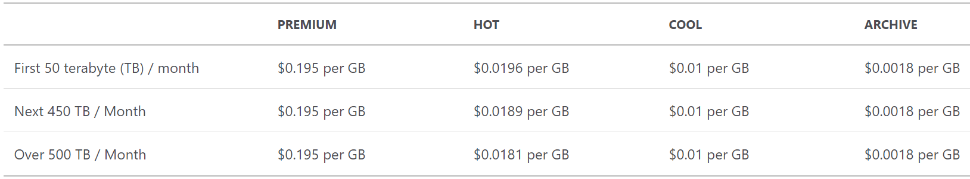
Cloud Storage
After 1 year: 221TB => 398$

Slide 46
Muscar.auto
Architecture
User Interface / Service Interface
Business Logic
Data Access
Data Store

Slide 47
Muscar.auto
Telemetry Processor Redundancy
Load Balancer
Telemetry Processor
Telemetry Processor
Telemetry Processor

Slide 48
Muscar.auto
Components
Cars
Telemetry gateway
Receives telemetry from cars
Telemetry pipeline
Queues the telemetry messages for processing
Queries the operational DB and displays real time data
Telemetry processor
Validates the messages and stores them
Telemetry Viewer
Operational DB
Archive DB
Data Warehouse
Reports and analysis
BI Application

Slide 49
Muscar.auto
Telemetry Viewer
What it does:
Allows end users to query telemetry data
Displays real time data
What it doesn’t:
- Analyzes the data

Slide 50
Muscar.auto
Application Type
Web App & Web API
Mobile App
Console
Service
Desktop App

Slide 51

Muscar.auto
Technology Stack
Back End
Front End

Slide 52
Muscar.auto
Architecture
Service Interface
Business Logic
Data Access
Data Store

Slide 53
Muscar.auto
API
Get latest errors for all cars
Get latest telemetry for specific car
Get latest errors for specific car

Slide 54
Muscar.auto
API
Functionality | Path | Return Codes
Get latest errors for all cars | GET /api/v1/telemetry/errors | 200 OK
Get latest telemetry for specific car | GET /api/v1/telemetry/{carId} | 200 OK 404 Not Found
Get latest errors for specific car | GET /api/v1/telemetry/errors/{carId} | 200 Ok 404 Not Found

Slide 55
Muscar.auto
Telemetry Viewer Redundancy
Load Balancer
Telemetry Viewer
Telemetry Viewer
Telemetry Viewer

Slide 56
Muscar.auto
Components
Cars
Telemetry gateway
Receives telemetry from cars
Telemetry pipeline
Queues the telemetry messages for processing
Queries the operational DB and displays real time data
Telemetry processor
Validates the messages and stores them
Telemetry Viewer
Operational DB
Archive DB
Data Warehouse
Reports and analysis
BI Application

Slide 57
Muscar.auto
BI Application
Business Intelligence
What it does:
Analyzes telemetry data
Displays custom reports about the data, trends, forecasts etc.
How many cars did break during the last month?
What is the total distance the cars drove?

Slide 58
Muscar.auto
Application Type
Doesn’t matter
BI Application is ALWAYS based on an existing tool

Slide 59




Muscar.auto
BI Tools

Slide 60
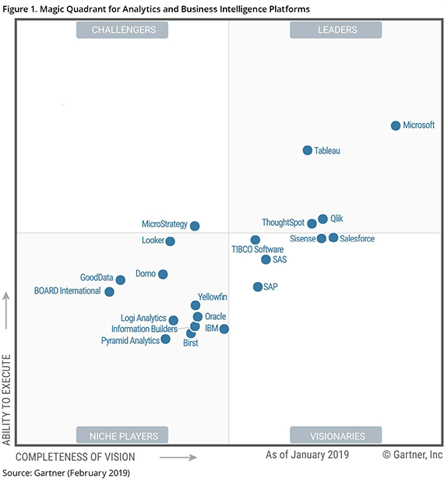
Muscar.auto
BI Tools

Slide 61
Muscar.auto
BI Tools
An important lesson:
Designing BI solution is NOT part of the architect’s job
ALWAYS use BI expert for this task

Slide 62
Muscar.auto
Logic Diagram
Cars
Telemetry gateway
Telemetry pipeline
Telemetry processor
Telemetry Viewer
Operational DB
Archive DB
Data Warehouse
BI Application

Slide 63
Muscar.auto
Technical Diagram
Cars
Telemetry gateway
NodeJS
Telemetry pipeline
Kafka
Telemetry processor
Telemetry Viewer
NodeJS
NodeJS
Operational DB
Archive DB
Data Warehouse
???
BI Application
MongoDB
Azure Storage

Slide 64
Muscar.auto
Physical Diagram
LB
Cars
Telemetry gateway
Telemetry gateway
Telemetry gateway
Product’s High Availability
Telemetry pipeline
LB
LB
Telemetry processor
Product’s High Availability
Telemetry Viewer
Telemetry processor
Telemetry Viewer
Telemetry processor
Telemetry Viewer
Operational DB
Archive DB
Data Warehouse
BI Application

